Slide 1

Professional
Development
Strengthening Professionals
BRINGING VALUE TO MEMBERSHIP
NAHU Professional Development Committee
August, 2017
PDC Presentation 2017-18 v.2

Slide 2

It’s a New Day
Welcome to a new PDC
Our motto is “Strengthening Professionals”
If what we are doing isn’t helping a member get a client
or keep a client, we’re not doing our job right!
Let’s start!

Slide 3
1
About us

2
Committee Leadership

3
Goals

4
Resources


Slide 4
5
NAHU Exclusive Benefits

6
Working Together
✶
7
Questions
?

End of presentation
Thank you for your attention

Slide 5
About Us
Professional Development
“Preparing our members for the new challenges and market realities
required a change from education to Professional Development… Strengthening Professionals is work we’ll never stop doing.”
PDC is moving from its regional communications focus to an active working committee, following the examples of NAHU’s Legislative and Membership Council. Each committee member will be involved in hands on work to further services and raise the level of programs and resources for NAHU members and our chapters nationwide
IDEA
www.nahu.org

Slide 7

Ashley W. Kapostins
Farren Ross Baer
Karen Kirkpatrick
2017-18 PDC Chair
Professional Development SVP
2017-18 PDC Vice Chair
CommitteeLeadership
Professional Development

Slide 8
CommitteeLeadership
Dedicated Staff

Farren Baer runs day-to-day programs and services as NAHU’s Senior Vice President for Professional Development fbaer@nahu.org
Dagmar Byrnes is NAHU’s dedicated senior manager of Education Operations dbyrnes@nahu.org
Hiring two additional staff positions

Slide 9
State & NationalRecognition
NAHU Professional Development
Today, NAHU is recognized as an approved provider of education through every Department of Insurance across the country
An approved vendor for the CMS Federally Facilitated Marketplace broker training/certification.
Provider of the DC Health Link broker training
2017 owner/provider of the REBC and ChHC designation acquired from the American College.

Slide 10
Committee organization
and
objectives
Professional
Development
Strengthening Professionals

Slide 11













Professional Life Cycle
NAHU Professional Development
Account Manager
Producer

Slide 12







Professional Life Cycle
NAHU Professional Development
Agency Management & Owners Track

Slide 13

2017-18Working Groups
Professional Development
COMMUNICATION
PROGRAMS
RAPID REACTION
Professional
Development
CERTIFICATIONS
REBC™

Slide 14


Changing HowWe Communicate
Multiple Avenues

Slide 15
WorkingTogether
NAHU Standing Committees
Legislative Council
Membership Council
○



✶
Media Relations
Professional Development
Chapter Development
IDEA
www.nahu.org

Slide 16
nahu.org:
What PD Resources are available online
Professional
Development
Strengthening Professionals

Slide 17

PDResources
Professional Development
http://www.nahu.org/education/resources/index.cfm

Slide 18
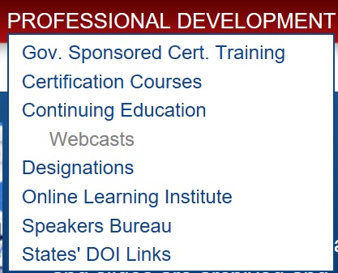
PDResources
Professional Development
NAHU is one of three vendors providing agent and broker training on the Marketplace
  The only agent association chosen to provide this required training nationally, and the top choice of paid training option
  First year success – over 4,000 agents completed their training through NAHU
  Already conditionally approved by CMS for the 2017 annual enrollment period

Slide 19
PDResources
Professional Development
The premier provider of top certification programs for agents & brokers nationally
  Two new programs: Benefit Account Manager (BAM) and Medicare
  Six existing programs:
    Consumer Directed Health Care (CDHC)
    HIPAA Privacy & Security
    Patient Protection & Affordable Care Act (PPACA)
    Self-Funded
    Voluntary/Worksite
    Wellness

Slide 20






2017-18 Current Certifications
Professional Development
Patient Protection and Affordable Care Act
Voluntary Worksite
HIPAA Privacy & Security
Consumer-Directed Healthcare
Corporate Wellness
Benefits Technology
Self Funding
Benefit Account Manager
Medicare
Advanced Self Funding
www.nahu.org

Slide 21
PDResources
Professional Development
Great opportunity for live programs
Available for:
    CDHC (Consumer Directed Health Care)
    PPACA (partial)
    Self-Funded
    Voluntary/Worksite
    Medicare
    Wellness
  Programs are 2-4 hours depending on course
  Chapter income-share requires a minimum of 50 registrants

Slide 22
PDResources
Professional Development
Live Instruction – NAHU Provides:
  The course instructor(s)
  Course handout materials delivered to location
  National promotion of the event
  Reporting of C.E. credits to relevant state insurance department/agency
  Exam and all exam costs
  Student service support call center
  Online or onsite registration processes

Slide 23
PDResources
Professional Development
Online continuing education programs available for our members
  NAHU Programs
    Ethics Training
    Health Insurance 101
  Discounts with other national providers
    IFEBP (Int’l Foundation of Employee Benefit Plans)
    AHIP (America’s Health Insurance Plans)
    LTC (Long Term Care) Consultants
    InsuranceStudy.com
    National Underwriter

Slide 24
PDResources
Professional Development
Access the member-exclusive webinar series: Running Your Business
  Webinar series focused on providing relevant information to agency owners

Slide 25

PDResources
Professional Development
NAHU is taking over American College’s employee benefits related designations:
  RHU (Registered Health Underwriter) in process of being phased out by American College
  REBC (Registered Employee Benefits Consultant) is being revamped (more at convention)
    Integrate individual portion of ChHC (Chartered Healthcare Consultant) and other NAHU certification programs
    Adding disability and LTC (Long Term Care) electives

Slide 26
PDResources
Professional Development
NAHU also has discount programs for other national designation programs
  CLTC – Certified in Long Term Care
    http://www.cltcdemo.com/

Slide 27
PDResources
Professional Development
Variety of alternative learning formats for members’ continuing education needs, including:
  On-demand learning library (CE and non-CE content)
  Audio workshops (available for download)
  Live webinars/teleconferences (web + audio content)
    If someone cannot attend live webinar sessions, can still purchase recorded version of sessions that includes a synchronized web and audio recording, plus the accompanying PowerPoint presentation and other handouts.

Slide 28
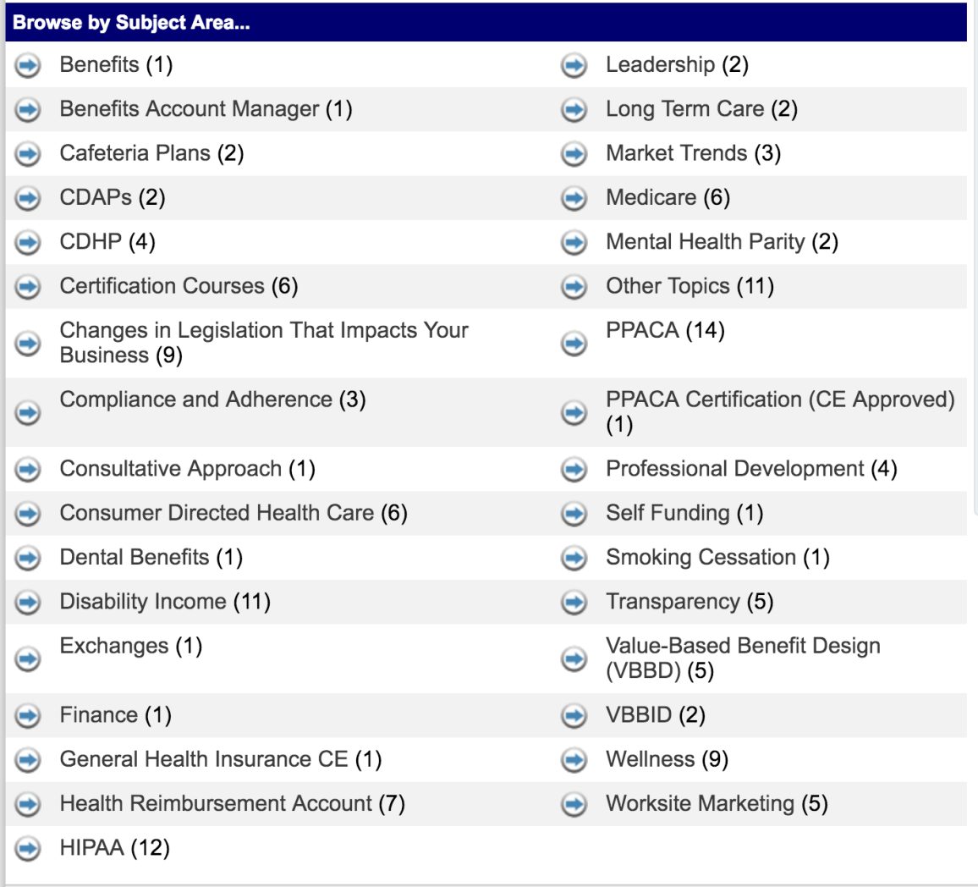
PDResources
Professional Development
Lots of content available through OLI

Slide 29
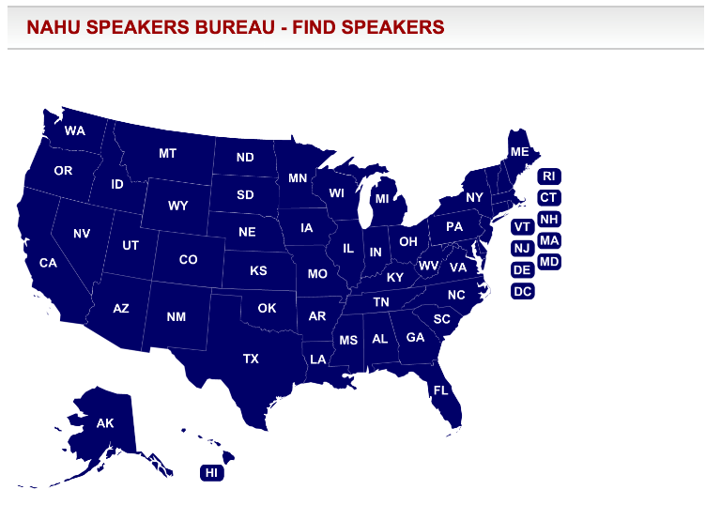
PDResources
Professional Development
NAHU Speakers Bureau
  Your one-stop source for information about accredited CE topics and speakers
  Speaker fees and expenses may fluctuate based on time and distance in travel
  http://www.nahu.org/education/speakers/findspeaker.cfm

Slide 30
PDResources
Professional Development
NAHU Speakers Bureau provides
  Searchable Database of Speakers
    Search by speaker name, topic or location
  Download all the information you need to book a speaker
  Submit his/her presentation to your state's Department of Insurance for approval

Slide 31
NAHUExclusive Benefits
Only available for NAHU Members
Legislative Resources: Web-accessible tools and information about PPACA, cost containment, exchanges/Marketplace, long-term care, Medicare and many other topics
Daily Newswire: Compilation of national news stories about the health insurance industry delivered daily to each member’s inbox
Washington Update: Weekly email summary of legislative and regulatory activities and compliance information
Compliance Webinars: Free monthly webinars with timely compliance information
Member-Only Communications: Email alerts on pertinent topics to ensure that our members are the first to know
www.nahu.org

Slide 32
ComplianceCorner
Professional Development Committee & Legislative Council
NAHU’s one-stop-shop for providing members with answers to specific compliance questions
  Members are often just an email or phone call away from a customized answer to any compliance question — one of the top values of NAHU membership!
FAQs and semi-monthly Blog with access to many health reform implementation questions and compliance concerns
Compliance Corner webinars on a variety of topics ranging from PPACA to HIPAA and ADA impact on Wellness. These webinars are free for members to listen to live or recorded, with access to slides and related material
http://www.nahu.org/education/programs/compliance.cfm
www.nahu.org

Slide 33
RunningYourBusiness
A New Member Only Service
NAHU New Webinar focused on giving members meaningful insight into issues related to running their businesses
First webinar in June led by a specialist with agency valuations and spoke how the agency merger & acquisition market looks
Future topics will include:
  Introducing Prezi – Next Generation presentation tool
  Succession Planning
  Selling using Value, Fees vs. Commissions
  Agency M&A
  Compensation Planning
The Single
best PROGRAM
FOR A SMALL
AGENCY I’VE
SEEN FROM
NAHU
http://www.nahu.org/education/programs/runningyourbusiness/index.cfm
www.nahu.org

Slide 34
WorkingTogether
How can we help?
⬆ Strengthening Professionals
D
With a clear goal shining the way,
PDC will be able to stay focused on continuing to enhance the quality of agents, brokers & consultants nationally.
Tell Us Your Needs 
C
We’ll do best by listening and providing chapters and leaders what you think will help you the most
 Program Development
We’re going to continue working on what’s next to continue to provide real value for NAHU membership
B
A1
A2
Members 
 Staff
IDEA
www.nahu.org

Slide 35
WorkingTogether
Information Gathering
Planning
Marketing
Implementation
Evaluation
Responsibilities of PD Chair
IDEA
www.nahu.org

Slide 36
WorkingTogether
Responsibilities of PD Chair
Information Gathering
Create a survey – ask what your members what in education
Entails learning what members want
Complete this step as early as possible to the start of the new year
Sample needs assessments are available within the PD Guidebook
IDEA
www.nahu.org

Slide 37
WorkingTogether
Responsibilities of PD Chair
Planning
Develop an education plan for the year
Create a annual calendar of event including all relevant details
Topic development – use the survey results to provide the best content for your members
Identify any programs that may need to be filled within your state DOI
IDEA
www.nahu.org

Slide 38
WorkingTogether
Responsibilities of PD Chair
Marketing
When creating your marketing plan, address the following:
Product
Prospects
Packaging
Promotion
Pricing
Mission statement of program
By conducting a promotional campaign, attendance at programs can be increased.
IDEA
www.nahu.org

Slide 39
WorkingTogether
Responsibilities of PD Chair
Implementation
Execute the plans identified on the planning calendar and manage and change plans as necessary
Identify effective speakers; schedule and follow up in a timely manner
Provide participant materials
Schedule meeting space with audiovisual and audience needs in mind
Set up a registration plan
IDEA
www.nahu.org

Slide 40
WorkingTogether
Responsibilities of PD Chair
Evaluation
Evaluate your programs after they occur using questionnaires, written examinations, performance test and/or observation
Sample speaker evaluation forms may be obtained from NAHU
Collect surveys as soon as possible after the program
IDEA
www.nahu.org

Slide 41


WorkingTogether
Gaining Recognition
Robert W. Osler Award
Local and state award given those that demonstrate exceptional leadership by providing outstanding professional development programs on health insurance and related topics to members, associates and the general public.
  Criteria can be found under Awards Guidebook: www.nahu.org/members/awards/2016_Awards_Guidebook.pdf
IDEA
www.nahu.org

Slide 42
?
Questions

